Slide 1
Building the Cognitive Era
Code. Community. Culture.
Seema Kumar
Leader, Developer Ecosystems Group India/SA
@seemapk

Slide 2

42%
Made buying decisions in 2016
75%
Will embed cognitive capabilities in apps
72%
Discuss dev needs with management

Slide 3
Building the Future
Language
Keywords Entities, Concepts, Taxonomy
Language, Relations, Author
Feeds, Date & Text Extraction
Speech
Speech to Text
Telephony Speech to Text
Keyword Spotting
Knowledge Organization
Watson Knowledge Studio
Document Conversion
Retrieve & Rank
Higher Reasoning
Conversation
Discovery
Language Translation
Foundational
Cognitive Skills
Empathy
Personality Insights
Tone Analyzer
Emotion Analysis
Vision
Image Classification
Face Detection & Attribution
Celebrity Recognition
Notes:
Broadest set of AI APIs, strength in combination play
Each AI, some ML/DL
Combination of APIs = Cognitive

Slide 4
Building a Culture for Cognitive Development
Cognitive
Development
1
Data is the fuel for AI. Your data is your differentiator!
Cognitive architecture matters.
Infuse Data Science into everything.
Data
Science
2
3
Architecture
Notes:
Data is the field for AI - Your Data is your differentiator (public, private, convergence)
Cognitive Architecture matters
Infuse Data Science into everything
Team dynamics will change moving forward – you’ll be partnering with Data Science, understand your role as a developer

Slide 5






IBM Cloud
Application
+ more…
Healthcare
Financial
Services
Logistics
DsX
IoT
Virtual agent
AI
Conversation
Discovery
Compare
+ Comply
Knowledge Query
Tone Analysis
Personality
Insights
Visual
Recognition
Speech
Document Conversion
Nat. Language Understanding
Nat. Language Classifier
+ more...
Data
Ingest
Enrich
Store
Analyze
Apply
The Watson Data Platform
Public, Private, Licensed
Cloud
Dev Services
Containers
Messaging
Blockchain
Logging
+ more...
Infrastructure
Storage
Compute
Physical Network
Infrastructure Mgmt
+ more...

Slide 6
Artificial Intelligence
Ability to reason like humans
Watson Conversation
Alexa
Playing chess
+ more…
Machine Learning
Ability to learn without explicit programming
Weather forecasting
Rankings
Learning to reduce error
+ more…
Deep Learning
Ability to learn new datasets on their own
Spam filters
Watson Health
News feed sorting
+ more…

Slide 7

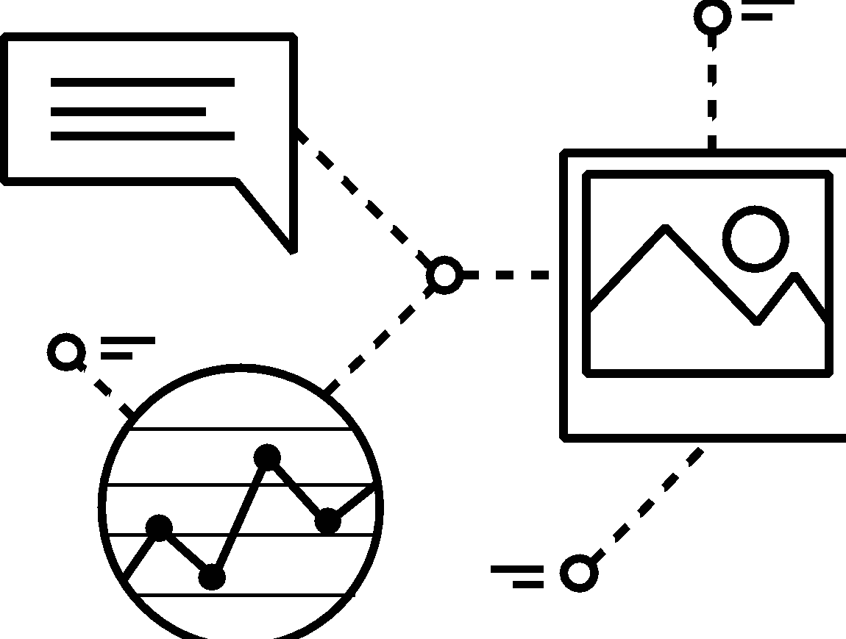


Cognitive System = ML + DL + AI
Understands
Reasons
Learns
Interacts
Understands imagery, language and other unstructured data like humans.
Reasons, forms hypotheses, infers and extracts ideas.
Sharpens expertise and continues learning with each interaction.
Sees, talks and hears to interact with humans in a natural way.

Slide 8



{ }
Code
Code
Community
Culture

Slide 9


https://developer.ibm.com/code/
Signup for IBM Bluemix
http://ibm.biz/DevConn

Slide 10






Stay Connected and continue coding !
Code & instructions available here https://github.com/IBMDevConnect17/
Join our Meetup groups
Mumbai : https://www.meetup.com/Cloud-Mumbai-Meetup/
Join developerWorks India Community
https://developer.ibm.com/in/
Check out the cool developer journeys
https://developer.ibm.com/code/
Join Data Science Experience now!
https://datascience.ibm.com/
Join our Slack team and stay in touch with the experts
https://ibmdevconnect.slack.com
Send in your request to - http://ibm.biz/slackrequest
Apply for the IBM Global Entrepreneur program
https://developer.ibm.com/startups/

Slide 11


Please give us your valuable feedback
http://ibm.biz/devconnect17

Slide 12


